Slide 1
COMP 2310 Data Structures and Algorithms
Lecture 3
Recursion

Slide 2
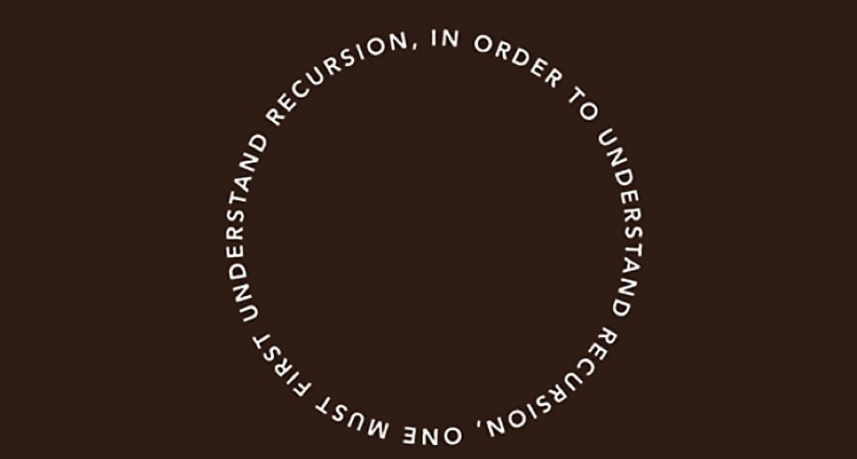
Introduction to Recursion

Slide 3
The Handshake Problem
There are n people in a room. If each person shakes hands once with every other person. What is the total number h(n) of handshakes?
h(n) = (n-1)+(n-2)+…+1
h(4) = 3+2+1= 6
h(3)=2+1=3
h(2) = 1
h(n): Sum of integers from 1 to n-1 = n(n-1) / 2

Slide 4
Recursion
Recursion is an effective programming technique in which a function calls itself.
Many computational problems can be solved easily using recursion if you think recursively.
h(n) = h(n-1) + n-1 ….
h(4) = h(3)+ 3=6
h(3)=h(2)+2=3
h(2) = 1
h(n): Sum of integers from 1 to n-1 = n(n-1) / 2
Notes:
Recursion is an effective programming technique in which a function (method) calls itself.
Something is defined in terms of a smaller version itself.
It provides a unique conceptual framework for solving important computational problems.
Many computational problems can be solved easily using recursion if you think recursively.
In this section first we will study some recursion examples: Triangular numbers, factorials, Fibonacci numbers and Towers of Hanoi.

Slide 5
Base Case in Recursion
Each successive recursive call should bring the solution closer to a situation in which the answer is Known.
A case for which the answer is known and can be expressed without recursion is called a base case.
Each recursive algorithm must have at least one base case, as well as the general recursive case.

Slide 6
Recursion – Some Examples
Factorials
Fibonacci numbers
Triangular numbers
Towers of Hanoi
Notes:
Recursion is an effective programming technique in which a function (method) calls itself.
Something is defined in terms of a smaller version itself.
It provides a unique conceptual framework for solving important computational problems.
Many computational problems can be solved easily using recursion if you think recursively.
In this section first we will study some recursion examples: Triangular numbers, factorials, Fibonacci numbers and Towers of Hanoi.

Slide 7
Demonstrating Recursion with Factorials
n! = F(n) , 0!=1!=1
= n(n-1)(n-2)…(3)(2)(1)
EX: 5!=5*4*3*2*1
n! = n F(n-1)
Pseudocode
C++
Factorial(n)
if n<1
then return 1
else
return n * Factorial(n-1)
factorial(int n)
{
if(n<1)
return 1;
else
return n*factorial(n-1);
}

Slide 8
How Recursion Works?
Example1 : Find 3!
There will be no computation until n=0.
(We assume that base case is: 0!=1)
3!=3*factorial(2)
6
Version 1
return 3*factorial(2)
3*2
Version 2
return 2*factorial(1)
2*1
Version 3
return 1*factorial(0)
1*1
Complexity : f(n)=O(n)
Version 4
return 1
Notes:
8

Slide 9
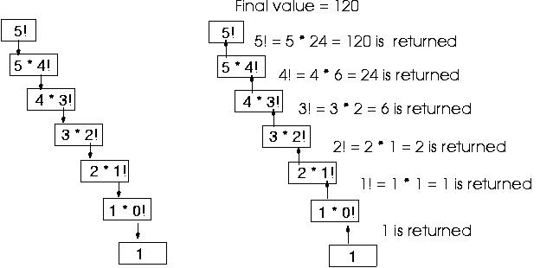
How Recursion Works?
Example 2: n=5
No computation until base case! Computations proceed upward

Slide 10
Recursions with Fibonacci Numbers
Example: Calculating F₀=1, F₁ =1, F₂ =2, F₃ =3, F₄=5,…..
Fibonacci numbers.
→ F_{i}=F_{i-1} +F_{i-2} , i>1.
Ex: 5=3+2, 8=5+3,….
Pseudocode
C++
int Fib(int n)
{
if(n<=1)
return 1;
else
return Fib(n-1)+Fib(n-2)
}
Fib(n)
if(n≤=1)
return 1
else
return Fib(n-1)+Fib(n-2)
;
Notes:
10

Slide 11
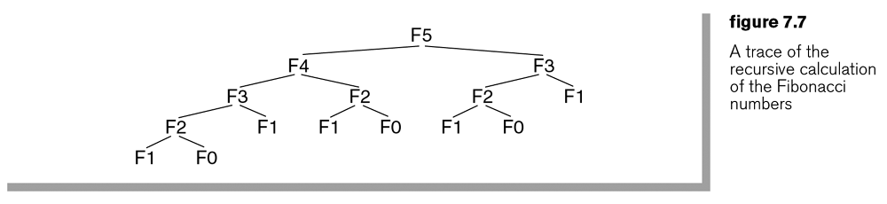
Recursion Tree of Recursive Fib() Function

Slide 12

Complexity of Fibonacci
$$T\left(n\right): T\text{otal} \text{run} \text{time} \\ \text{For} n=1, 2 \\ T(1)=1 \\ T(2)=1 \\ \text{For} n>2 \\ T(n)=T(n−1)+T(n−2)$$
Complexity : f(n)=O(2^{n}) Exponential time! Why?
Because there are too many unnecessary recursive calls.
Notes:
12

Slide 13
Iterative Version of Fibonacci Function
Here we don’t use recursion, instead we use a simple loop:
int fib(int n)
{
int F[n+1];
F[1] = F[2] = 1;
for (int i = 3; i <= n; i++)
F[i] = F[i-1] + F[i-2];
return F[n]
}
Time Complexity: O(n).

Slide 14
The Golden Ratio
The ratio of two consecutive Fibonacci Numbers approaches to 1.618
This is called the Golden (or divine) Ratio.
21/15 = 1.61518,…, 233/144 = 1.618055… → 1.618
An interesting example: A DNA molecule measures 34 angstroms by 21 angstroms at each full cycle of the double helix spiral.
21 and 34 are successive Fibonacci numbers!
Notes:
The ratio of two consecutive Fibonacci Numbers approaches to 1.618
This is called the Golden (or divine) Ratio.
21/15 = 1.61518,…,233/144 =1.618055… →1.618
The Golden Ratio has many examples in nature and has been used extensively in many areas of art and science including; Mathematics , sculpture, painting, music, aestethics, finance…
An interesting example : A DNA molecule measures 34 angstroms by 21 angstroms at each full cycle of the double helix spiral.
21 and 34 are successive Fibonacci numbers !

Slide 15
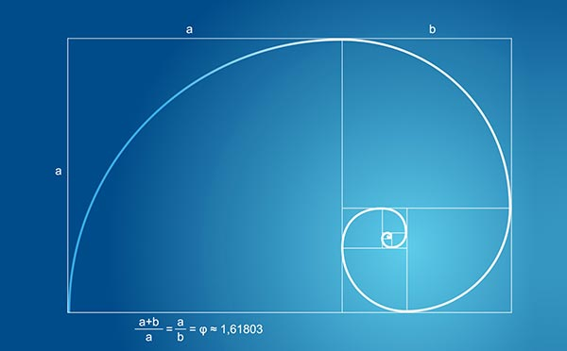
Notice the ratio:
(a+b)/a = a/b
=1.618
The Golden Ratio is considered as an indication of “beauty”.

Slide 16
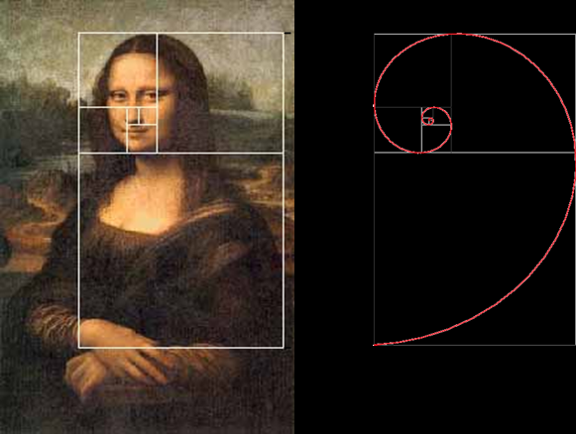
Leonardo Da Vinci Used the Golden Ratio

Slide 17
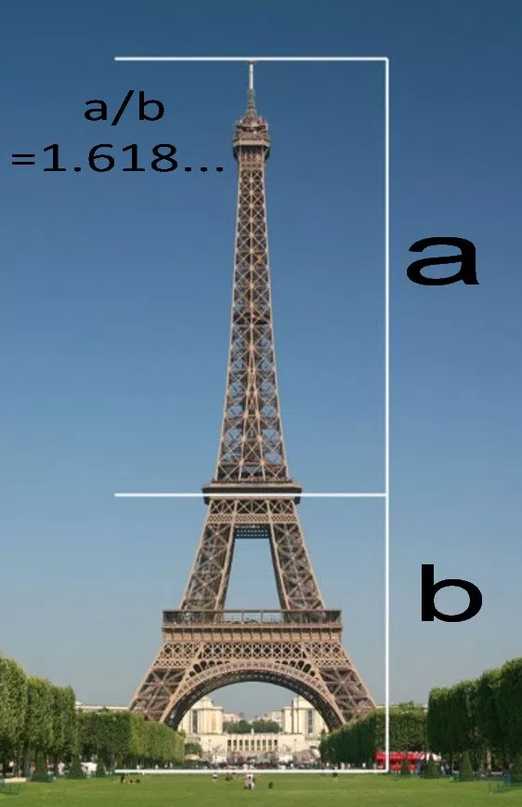
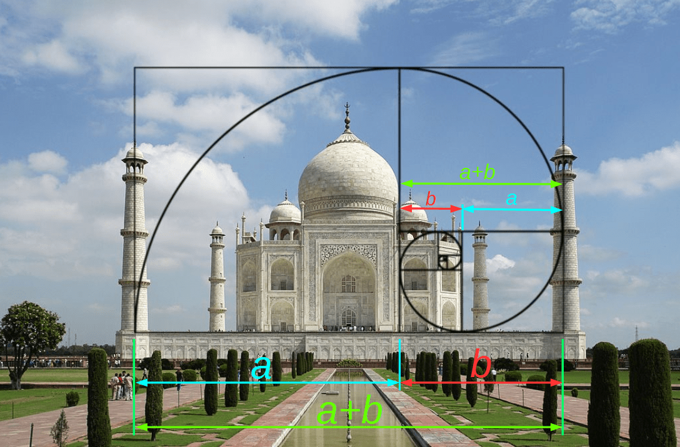

Slide 18
Example: Triangular Numbers
Consider the series of numbers: 1, 3, 6, 10, 15, 21, 28,...
Is there a relationship between the numbers?
n=1
i=1
n=3
i=2
n=6
i=3
n=10
i=4
n=15
i=5
n=21
i=6
n=28
i=7
How can we get the i^{th} value of n using i?

Slide 19
Triangular Numbers
What is the value of the i^{th} term (Total) in the series?
i
1
2
3
4
Total # boxes 1 3 6 10 : 3=2+1, 6=3+3…

Slide 20
Triangular Numbers: Iterative Solution
The following function TotNum() uses iterative technique to find the total value (n) of the i^{th} term in the series.
Pseudocode
C++
TotNum(i )
Total 0
while(i > 0)
Total Total + i
i i -1
return TotNum
int TotNum(int i)
{
int TotNum = 0;
while(i > 0)
{
total = total + i;
--i;
}
return total;
}

Slide 21
Recursive Solution
Another way of finding the total value of the i^{th} term in the series: Recursion. The total value of the i^{th} term in the series is obtained by adding i to the previous total.
The value of the i^{th} term can be obtained as the sum of only two things
1. The last column, which has the value i.
2. The sum of all the previous columns.
Recursive formulation :
TotNum =1 if i=1
TotNum(i) = i + TotNum(i-1) if i>1

Slide 22
Recursive Solution
We can use recursion to solve the problem:
Pseudocode
C++
TotNum(i )
if i=1
then return 1
else
return (i + TotNum(i-1))
int TotNum(int i)
{
if(i==1)
return 1;
else
return (i + TotNum(i-1));
}
Complexity: f(n) = O(n)

Slide 23
Recursion: Reversing an Array
ReverseArray(A, i, j):
Input: An array A and nonnegative integer indices i and j
Output: The reversal of the elements in A starting at i, i ending at j
if i < j then
Swap ( A[i] , A[ j] ) //Exchange arguments
ReverseArray(A, i + 1, j - 1)
return

Slide 24
Reversing an Array Iterative Version
IterativeReverseArray(A, i, j)
while i < j do
Swap ( A[i] , A[ j] )
i = i + 1
j = j - 1

Slide 25
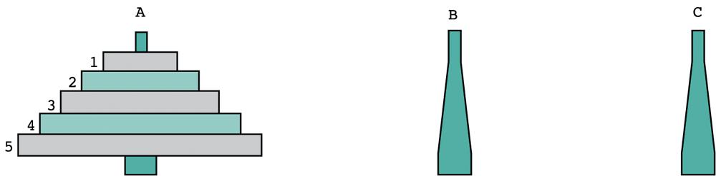
Recursion: Towers of Hanoi
The towers of Hanoi problem involves moving a number of disks (in different sizes) from one tower (or “peg”) to another.
Initially the game has a few discs arranged in increasing order of size in one of three towers.
The constraint is that a larger disk can never be placed on top of a smaller disk.
Only one disk can be moved at each time
Source
Auxiliary
Destination

Slide 26
Demonstrating Recursion with Towers of Hanoi
Informal algorithm
1) Move the top n-1 disks from Source to Auxiliary tower,
2) Move the n^{th} disk from Source to Destination tower,
3) Move the n-1 disks from Auxiliary tower to Destination tower.
Where is recursion?

Slide 27
Towers of Hanoi with Recursion: n=3
Source Tower Auxilary Tower Destination Tower

Slide 28
Towers of Hanoi with Recursion
n=3
Source Tower Auxilary Tower Destination Tower

Slide 29
Towers of Hanoi with Recursion
n=3
Source Tower Auxilary Tower Destination Tower

Slide 30
Towers of Hanoi with Recursion
n=3
Source Tower Auxilary Tower Destination Tower

Slide 31
Towers of Hanoi with Recursion
n=n-1
Source Tower Auxilary Tower Destination Tower
Now, we continue recursively, with n=n-1=2, using source as auxiliary.

Slide 32
Towers of Hanoi with Recursion
n=2
Source Tower Auxilary Tower Destination Tower

Slide 33
Towers of Hanoi with Recursion
n=1: Base case
Source Tower Auxilary Tower Destination Tower

Slide 34
Towers of Hanoi with Recursion
Solved!
Source Tower Auxilary Tower Destination Tower
How many moves did we perform?

Slide 35
Towers of Hanoi with Recursion
Try with n=4
Source Tower Auxilary Tower Destination Tower

Slide 36
Towers of Hanoi with Recursion
Try with n=4: Final state.
Source Tower Auxilary Tower Destination Tower
How many moves are needed?

Slide 37
Towers of Hanoi: Recursive Algorithm
The pseudocode:
TOH(n, source, destination, auxilary) //Move n disks from source to destination using auxilary tower)
if n=0 return //Base case
TOH(n-1, source, auxilary, destination) //Recursive call: n-1 disks
MOVE(source, destination); // Move bottom disk to destination
TOH(n-1, auxilary, destination, source) //Recursive call: n-1 disks.
//MOVE is an external function.

Slide 38
Towers of Hanoi: C++ Code
The C++ code // Pole is a suitable data type.
void TOH(int n, Pole source, Pole destination, Pole auxilary) {
if (n == 0) return; // Base case
TOH(n-1, source, auxilary, destination);
// Recursive call: n-1 disks
move(source, destination);
// Move bottom disk to destination
TOH(n-1, auxilary, destination, source);
// Recursive call: n-1 disks
}

Slide 39
Time Complexity of Towers of Hanoi
The Towers of Hanoi problem with 3 pegs and n disks takes T(n) = 2^{n} – 1
N=3→ 7
N=4→15
N=5→31
………..
N=64→ 2⁶⁴
>10 ¹⁹
In the real life, for N=64, allowing one move per second would require more than 500 billion years to complete the task!
Notes:
7+7+1
15+15+1
31+31+1

Slide 40
Properties of Recursive Solutions
The function calls itself with a new and smaller value of the parameter.
When it calls itself, it does so to solve a smaller problem.
There’s some version of the problem that is simple enough that the routine can solve it, and return, without calling itself: Base case

Slide 41
Properties of Recursive Solutions
The base case is the smallest problem that the routine solves and the value is returned to the calling method. (Terminal condition)
Calling a method involves certain overhead:
Transferring the control to the beginning of the method and
Storing the information of the return point.
Memory is used to store all the intermediate arguments and return values internally.
The overheads increase cost and might cause problems if there is a large amount of data, leading to overflows.

Slide 42
Efficiency of Recursion
Recursion is usually applied because it simplifies a problem conceptually, not because it is inherently more efficient.
In general, recursive methods may be less efficient than their iterative versions: Remember the complexity of recursive Fibonacci.
However, recursion can simplify the solution of a problem, often resulting in shorter source code.

Slide 43
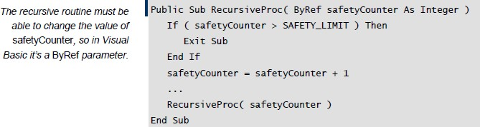
Tips for Using Recursion
Make sure the recursion stops
Use safety counters to prevent infinite recursion
Limit recursion to one routine

Slide 44
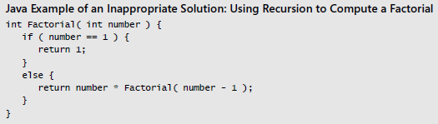
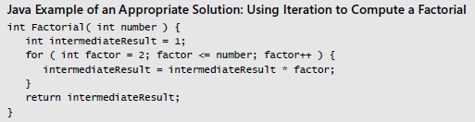
Tips for Using Recursion
Keep an eye on the stack
Don’t use recursion for factorials or Fibonacci numbers

